Slide 1

FINANCIAL ANALYTICS
The Intelligent Investor Is A Realist Who Sells To Optimists And Buy From Pessimists.
--BENJAMIN GRAHAM--

Slide 2
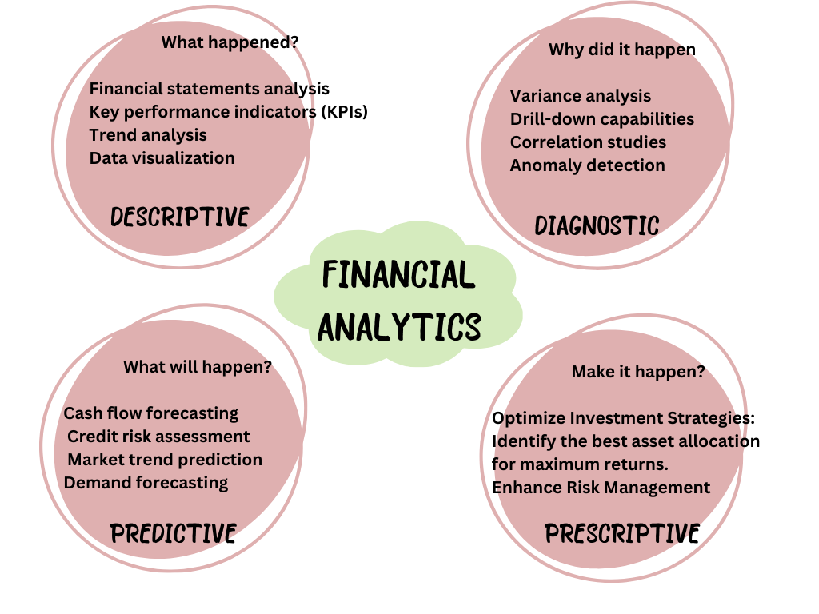
OVERVIEW OF FINANCIAL ANALYTICS
In today's data-driven business landscape, financial analytics has emerged as a
game-changer. 💼📊
But what exactly is it, and why should you care?
Imagine having a crystal ball that could predict your company's financial future, identify hidden opportunities, and safeguard against potential risks. That's the power of financial analytics in a nutshell.

Slide 3
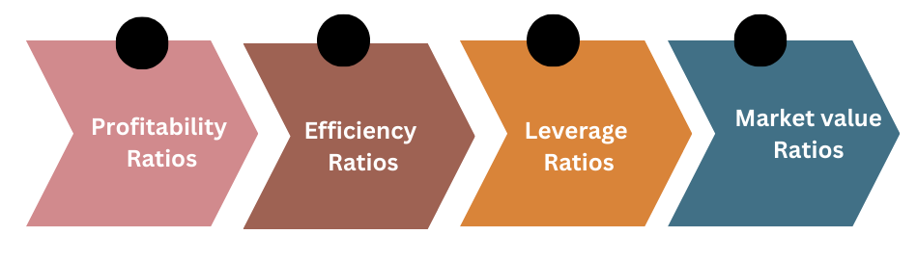
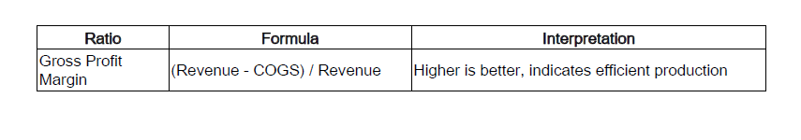
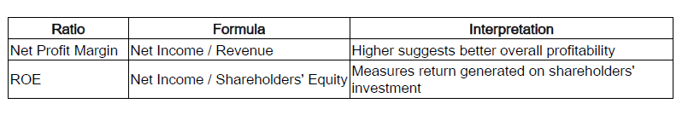
FINANCIAL METRICS

Slide 4
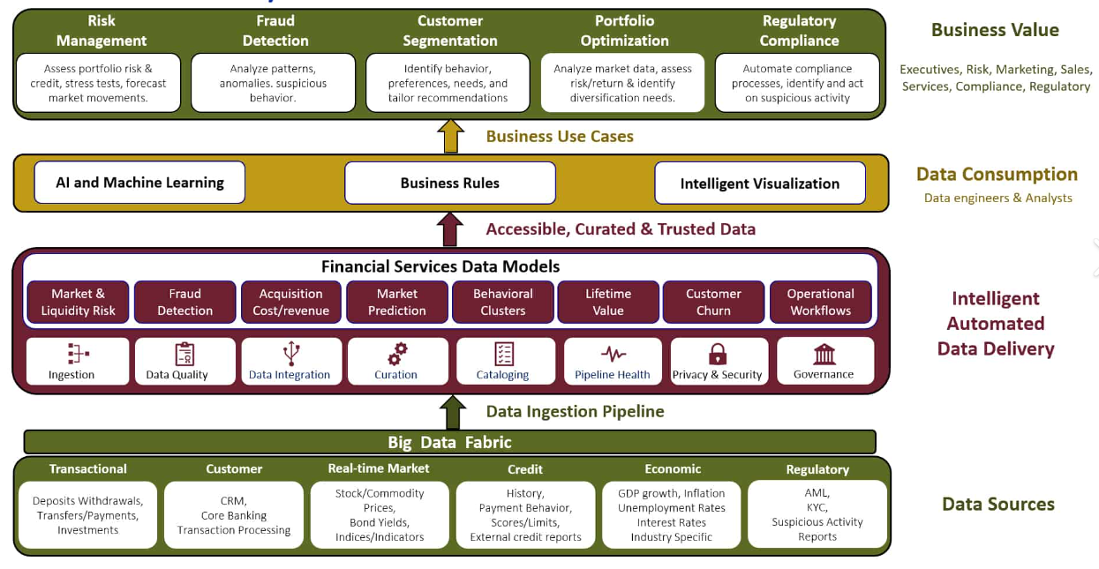
IMPLEMENTING DATA ANALYTICS IN FINANCIAL SERVICES

Slide 5
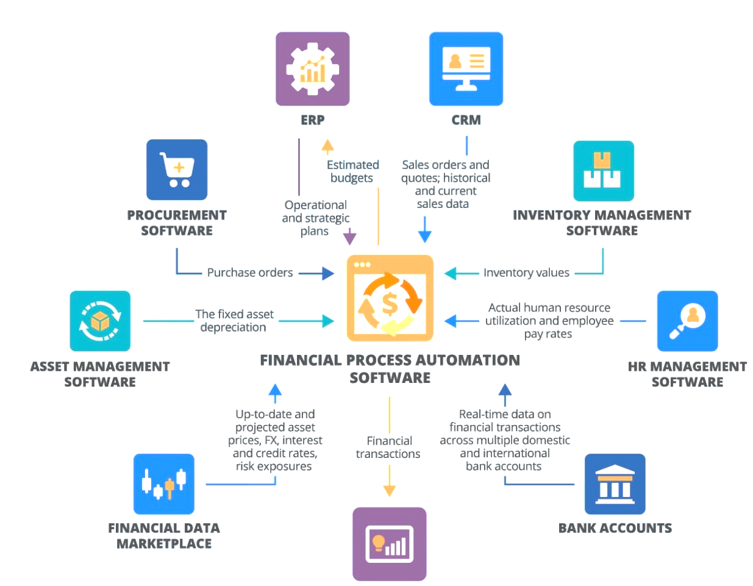
FINANCIAL PROCESS AUTOMATION
BI SOLUTION

Slide 6
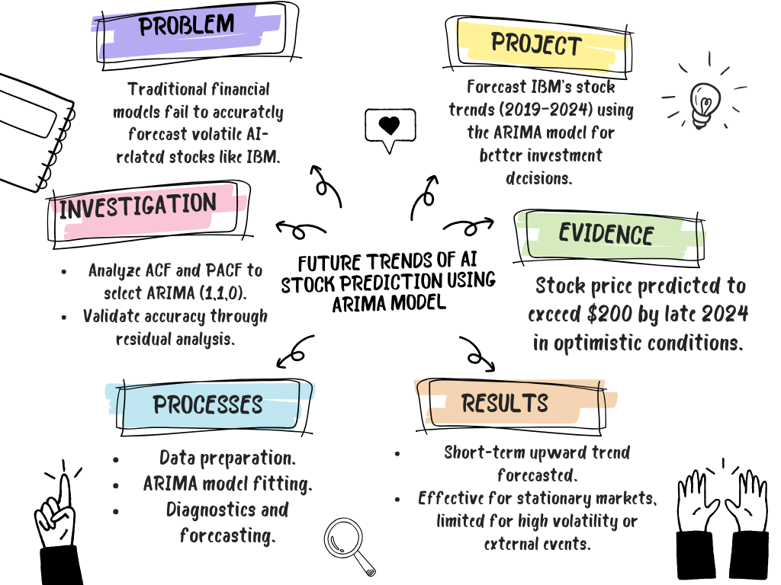

Slide 7
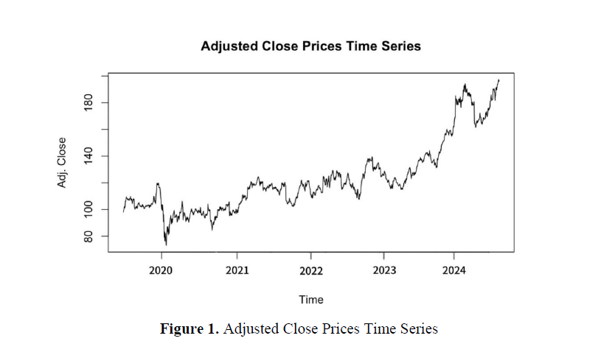
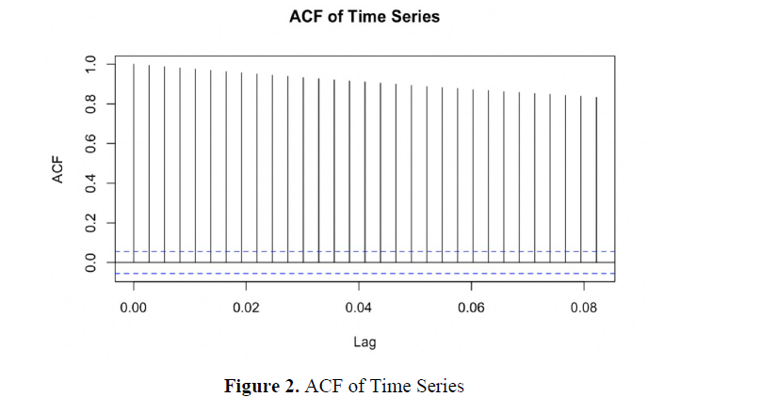

Slide 8
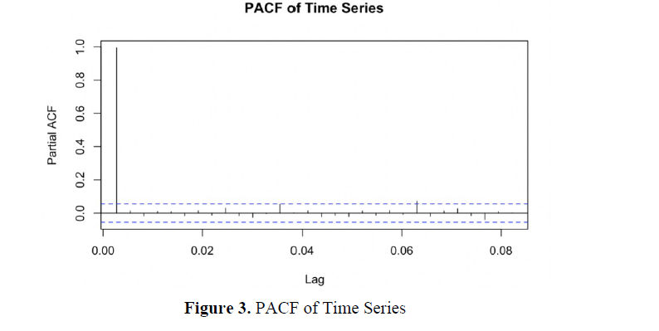
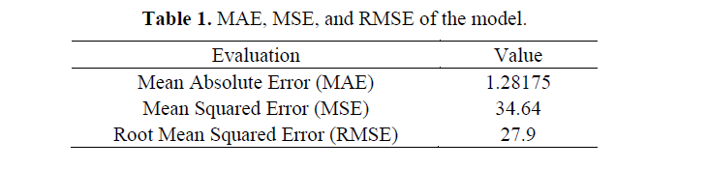

Slide 9
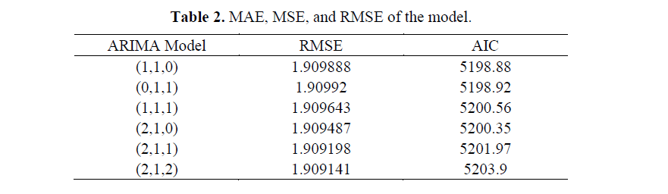
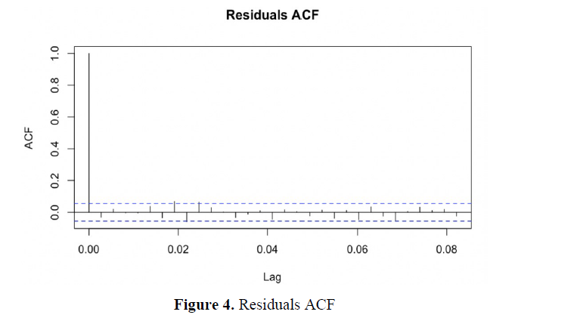

Slide 10
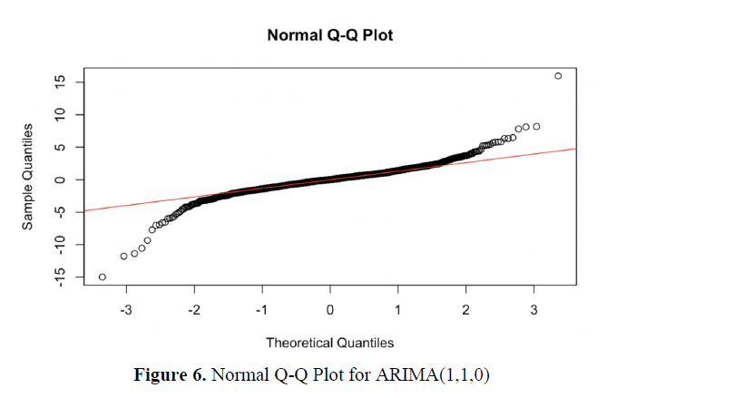
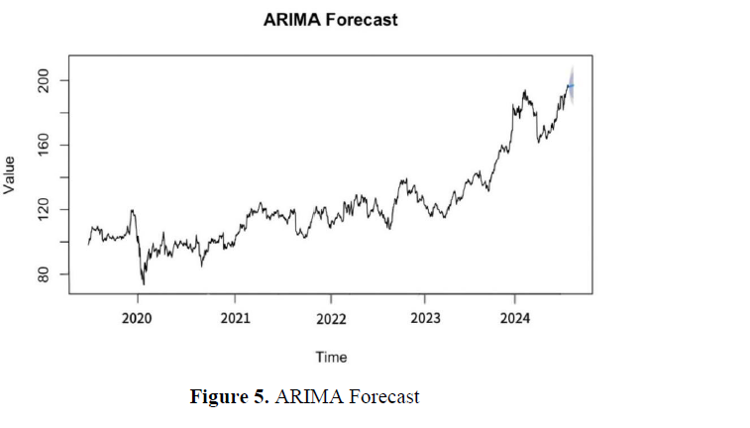

Slide 11










LEADING FINANCIAL ANALYTICAL COMPANIES WORLDWIDE
FactSet: Provides data and technology solutions for investment professionals.
S&P Global: Offers financial information, analytics, and ratings.
Morningstar: Known for investment research, data, and analytics.
Refinitiv: Delivers market data, pricing, and reference services.
IBM: Provides advanced analytics solutions for financial institutions.
Microsoft: Offers financial analytics tools through Azure and other platforms.
Oracle: Specializes in database and analytics solutions for financial services.
SAS Institute: Provides advanced analytics, business intelligence, and data management solutions.
FICO: Focuses on analytics and decision management solutions for financial services.
Hitachi Vantara: Offers data management and analytics solutions for various industries, including finance.

Slide 12
OUR CAPABILITIES
BUSINESS IMPACT
Predictive Analytics for Market Trends: Forecast future market trends and identify profitable investment opportunities.
Fraud Detection and Prevention: Detect anomalies and prevent financial fraud in real time using AI-based models.
Cash Flow Optimization: Analyze and predict cash flow patterns to ensure liquidity and financial stability.
Credit Risk Assessment: Evaluate borrower risk with predictive credit scoring models for better lending decisions.
Portfolio Management Insights: Optimize investment portfolios by assessing risks and maximizing returns.
Expense Optimization: Identify cost-saving opportunities by analyzing operational and financial performance.
Cost Savings: Reduce operational costs by identifying inefficiencies, leading to savings of up to 20-25%.
Revenue Growth: Increase revenue by leveraging data to uncover new business opportunities, improving profitability by 15-30%
Risk Mitigation: Minimize financial losses with advanced risk analytics and fraud detection systems.
Improved Decision-Making: Enable faster, data-driven financial decisions to stay competitive in a volatile market.
Compliance and Reporting: Streamline compliance with regulations and improve financial reporting accuracy.
Customer Retention: Enhance customer experience and loyalty through personalized financial services.

Slide 13
TOOLS AND TECHNOLOGIES
STATISTICAL ANALYSIS TOOLS
Statistical analysis is the backbone of financial analytics. Several software solutions cater to this need:
QuickBooks: Ideal for small and medium-sized businesses, offering invoicing, expense tracking, and payroll processing.
Oracle Essbase: Provides robust multidimensional database capabilities for OLAP and business intelligence applications.
NetSuite: A cloud-based ERP solution with extensive financial management features and real-time insights.
MACHINE LEARNING ALGORITHMS
Tools like SpotIQ use AI to uncover hidden trends and anomalies in financial data, helping identify cost optimization and revenue growth opportunities.
BIG DATA PLATFORMS
Data integration from multiple sources
Real-time processing of large datasets
Advanced analytics for trend identification and risk assessment
Platforms like Anaplan and Workday Adaptive Planning offer enterprise-level planning capabilities, streamlining financial processes and improving decision-making through integration with various systems.

Slide 14
APPLICATIONS OF FINANCIAL ANALYTICS
Banking & Finance
Risk management, fraud detection, investment assessment
Healthcare
Budget planning, compliance, revenue estimation
Retail
Customer personalization, inventory management, KPI monitoring
Manufacturing
Expense analysis, profitability analytics, production planning
Insurance
Risk assessment, fraud prevention, claims processing

Slide 15
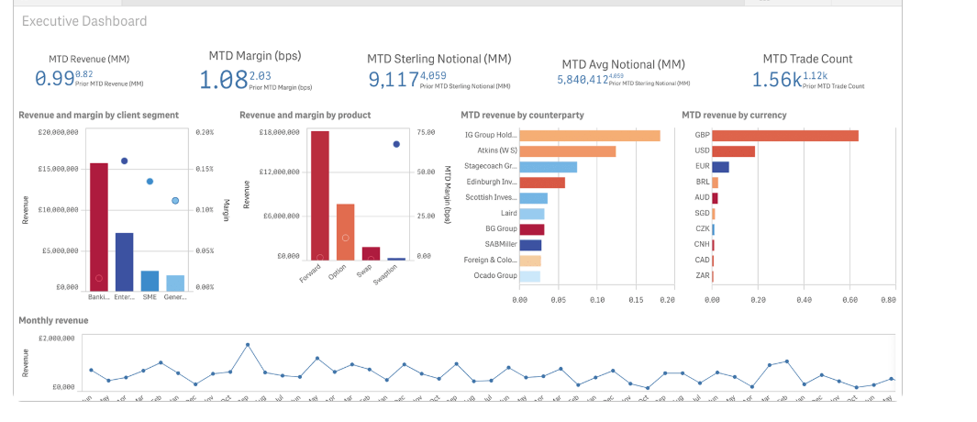
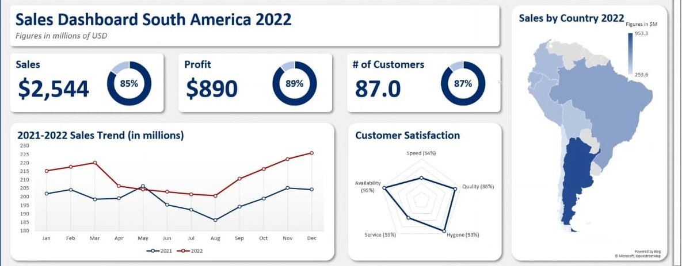
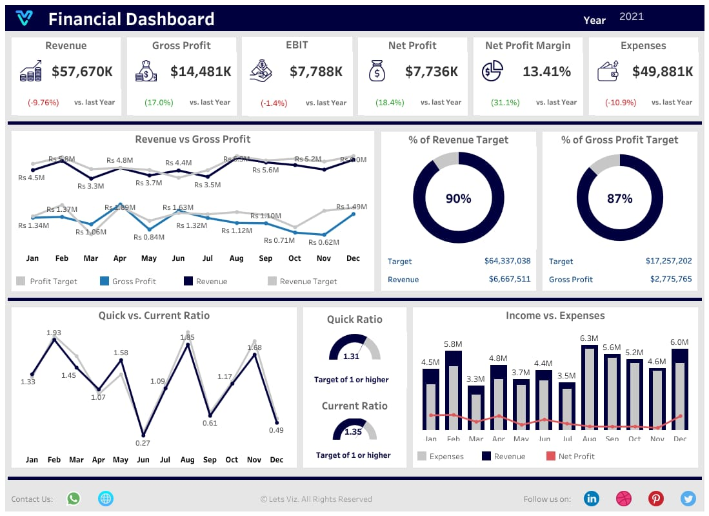
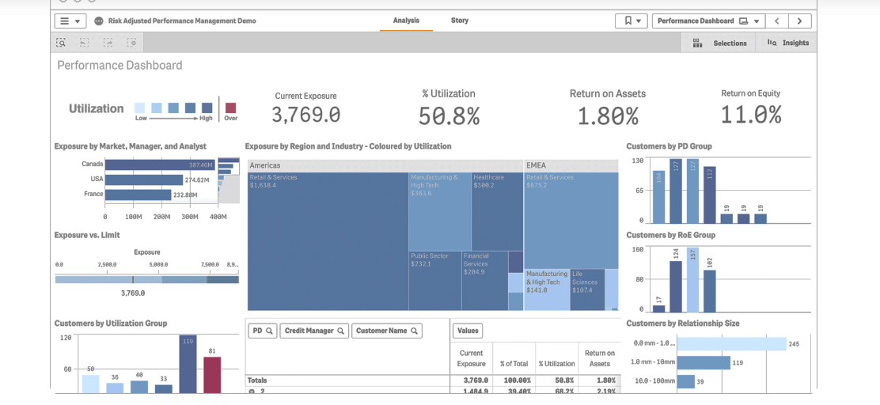
FINANCIAL DASHBOARDS

Slide 16
“WITHOUT BIG DATA ANLYTICS, COMPANIES ARE BLIND AND DEAF, WANDERING OUT ONTO THE WEB LIKE DEER ON A FREEWAY”
--GEOFFREY MOORE--

